Slide 1
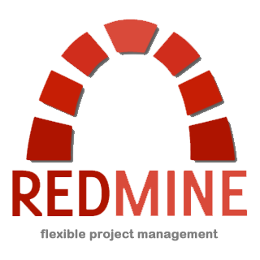
Redmine
Learn why Redmine @ RefreshCache is the community developer's new best friend.
Daniel Hazelbaker
Information Technology Director
High Desert Church
Email: daniel@highdesertchurch.com

Slide 2
Difficulties for the Developer
A developer must get their custom modules fully installed and functioning on an Arena installation.
You have to prepare all the SQL scripts.
Then you must export the custom modules as a new page.xml, requiring you to add all supplemental files needed one at a time without forgetting anything.
After that you have to find a different Arena installation that you can test this page.xml on to make sure that you remembered to include all the files, set the right paths, have the right module settings, etc. If anything is wrong you have to begin all over.
Finally you can upload your page.xml to the community server and announce that it is ready and hope everybody can find the correct version.
Difficulties for the End-User
As an end-user wanting to install the custom modules you have to find the latest version of the modules you want.
Download them and extract the package bundle.
Run the SQL installer script(s) on the Arena server, remembering to run them against the correct database.
Then you have to upload the page.xml into Arena. At that point you should have a working installation.
When you are ready to upgrade your version of Arena you have to call around and find out if it is going to break any custom modules or just try the upgrade and hope for the best.

Slide 3
Difficulties for the Developer
A developer must get their custom modules fully installed and functioning on an Arena installation.
You have to prepare all the SQL scripts.
Then you must export the custom modules as a new page.xml, requiring you to add all supplemental files needed one at a time without forgetting anything.
After that you have to find a different Arena installation that you can test this page.xml on to make sure that you remembered to include all the files, set the right paths, have the right module settings, etc. If anything is wrong you have to begin all over.
Finally you can upload your page.xml to the community server and announce that it is ready and hope everybody can find the correct version.
Difficulties for the End-User
As an end-user wanting to install the custom modules you have to find the latest version of the modules you want.
Download them and extract the package bundle.
Run the SQL installer script(s) on the Arena server, remembering to run them against the correct database.
Then you have to upload the page.xml into Arena. At that point you should have a working installation.
When you are ready to upgrade your version of Arena you have to call around and find out if it is going to break any custom modules or just try the upgrade and hope for the best.

Slide 4
Redmine
Solutions for the Developer
Centralized location to deploy your packages to in a manner that makes it easy for users to find the most recent version.
Issue Tracker, Feature Requests, Help Requests.
Discussion boards (Forums).
A wiki of your very own.
General documents can be made available for download.
Version specific files for download.
Source Code Management with web-based Repository browser.
Roadmap to determine how close you are to making another release.

Slide 5
Redmine
Solutions for the End-User
Centralized location to find packages and their most recent versions.
Issue Tracker, Feature Requests, Help Requests.
Discussion boards (Forums).
A wiki to get general installation (and other) help.
General documents can be downloaded.
Version specific files can be downloaded.
Roadmap to determine how close the developer is to making another release.

Slide 6
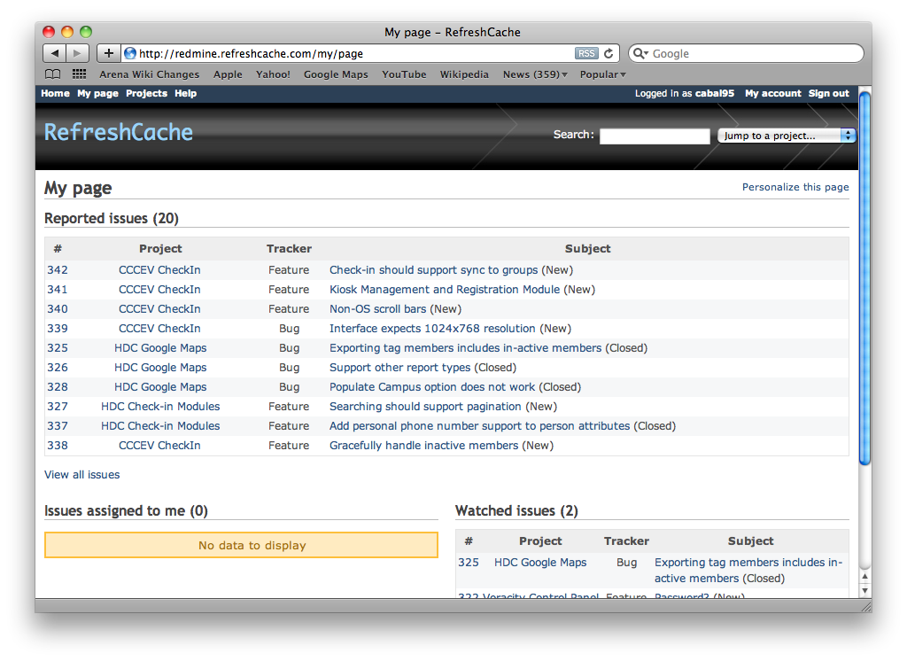

Slide 7
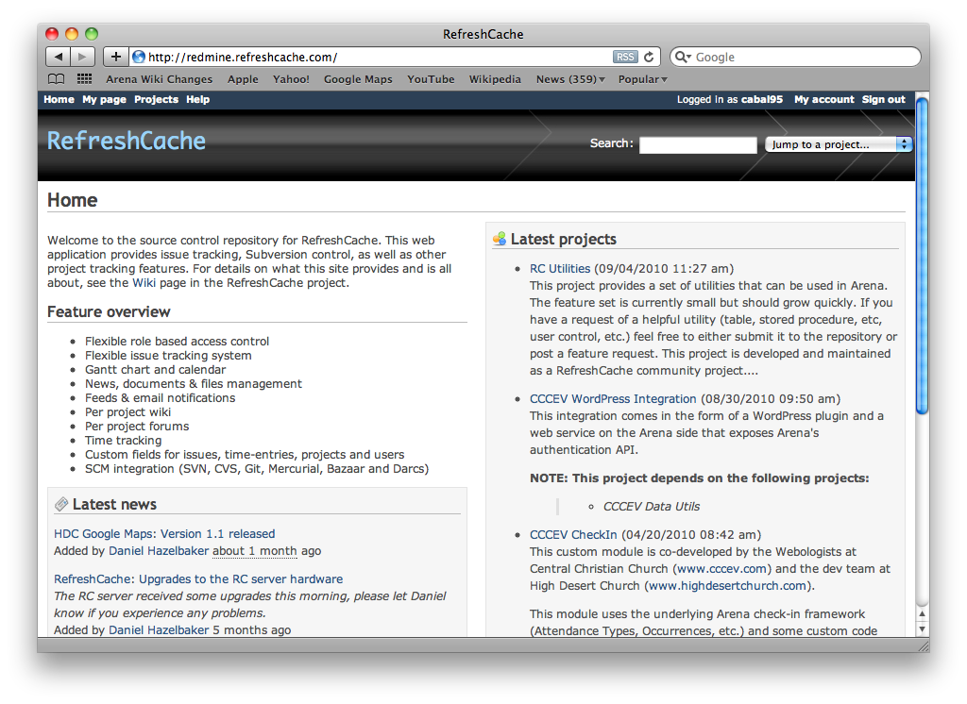

Slide 8
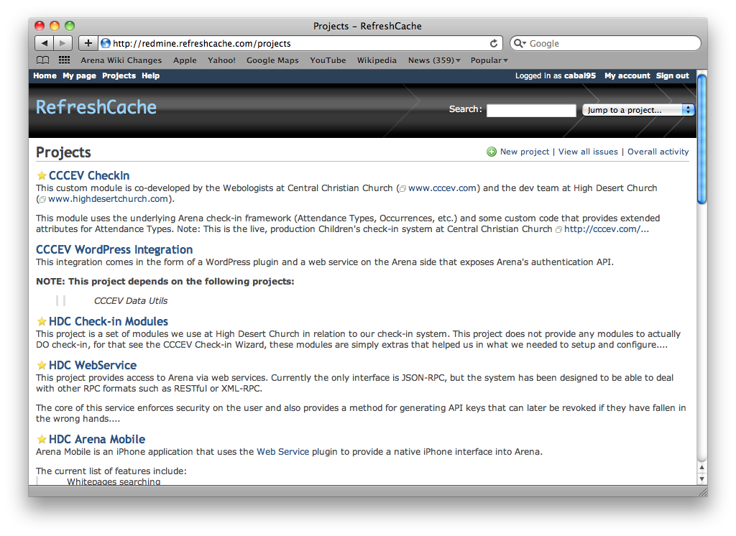

Slide 9
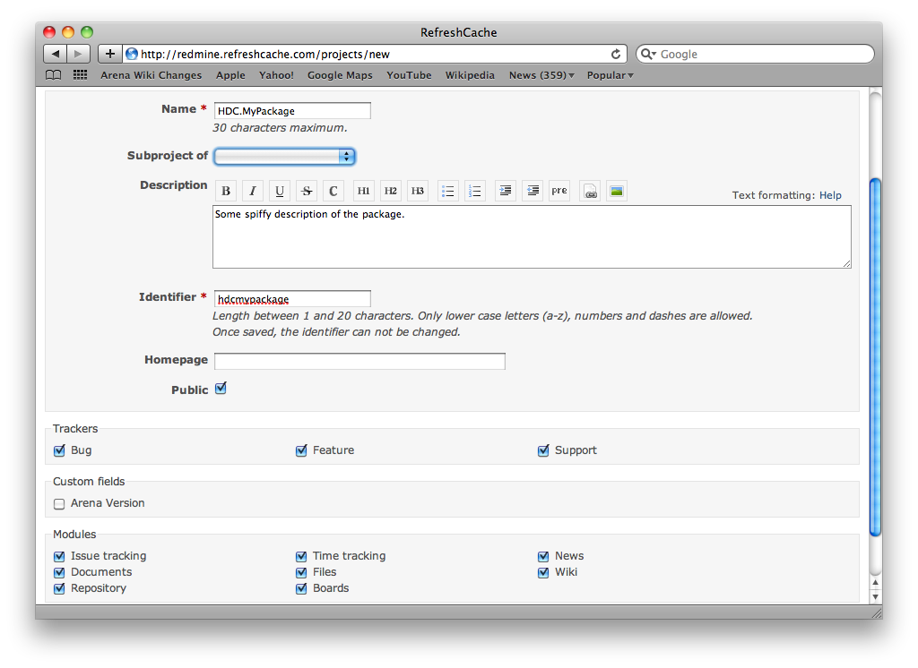

Slide 10
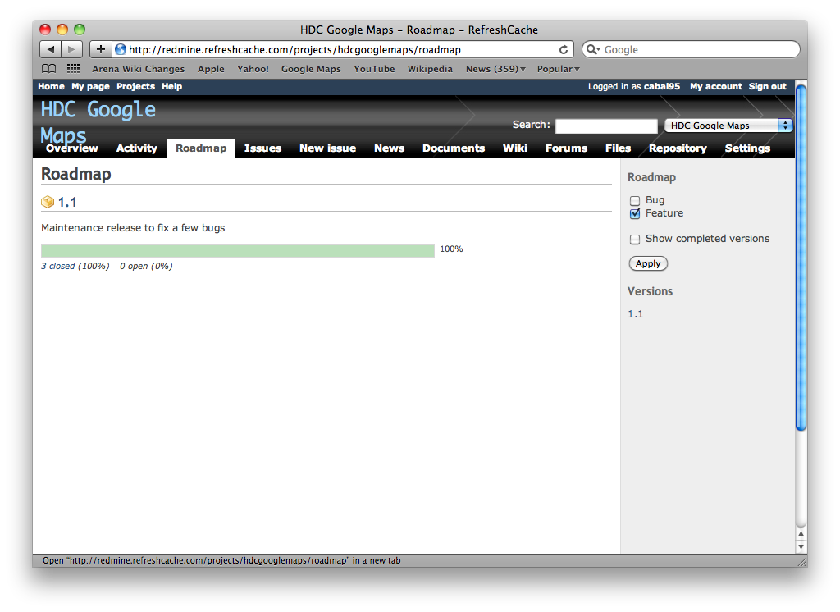

Slide 11
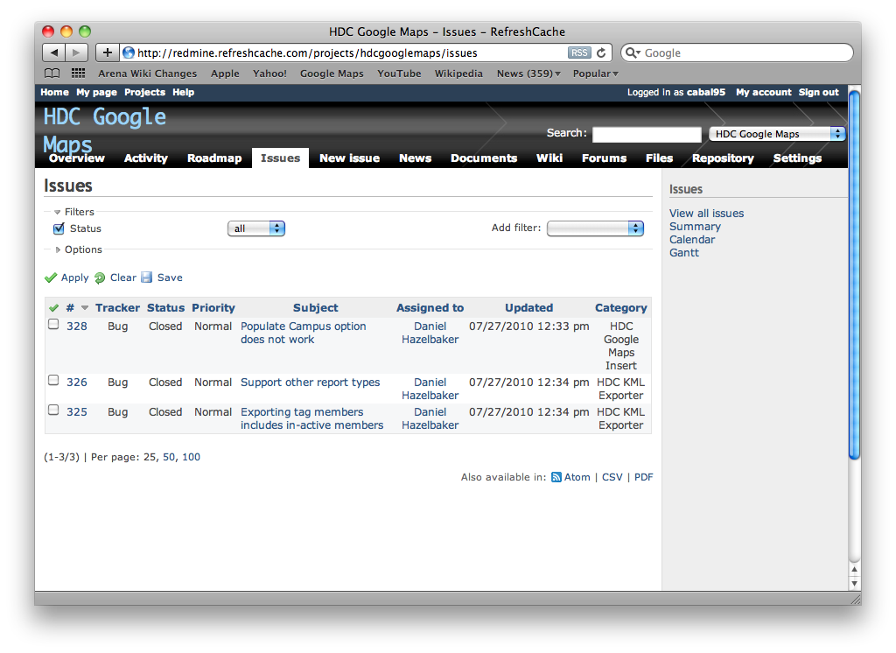

Slide 12
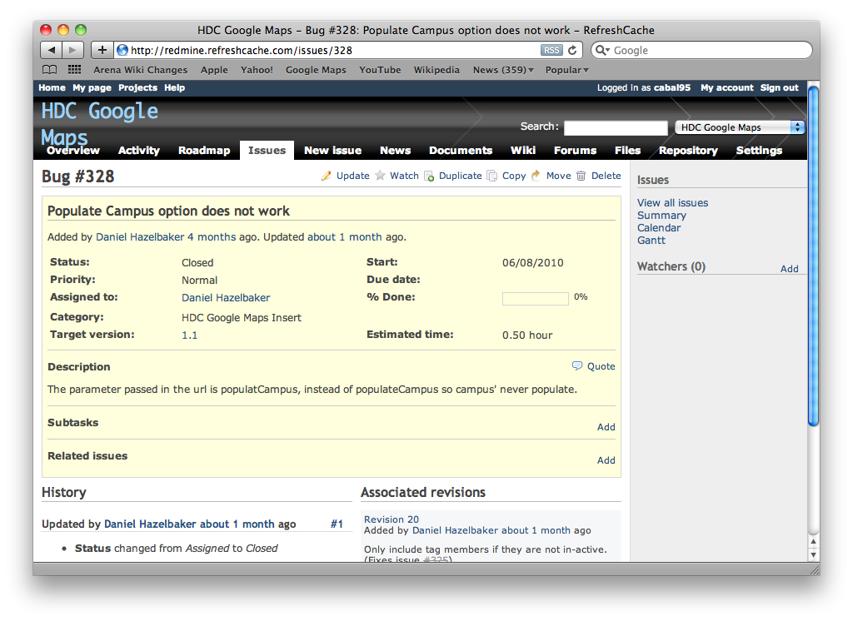

Slide 13
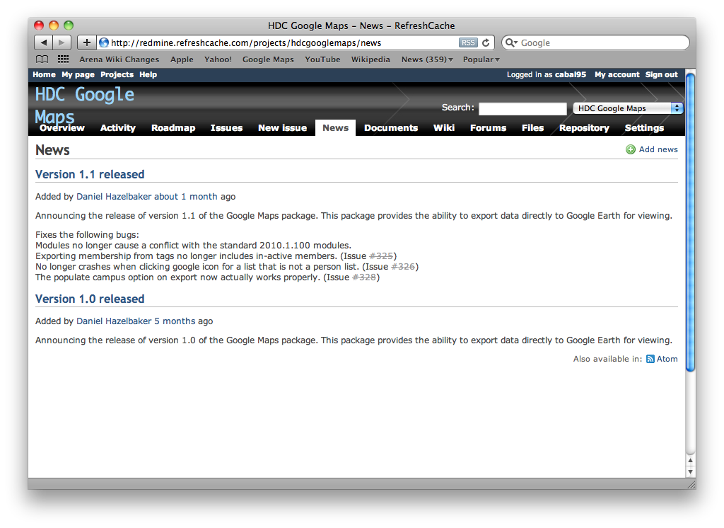

Slide 14
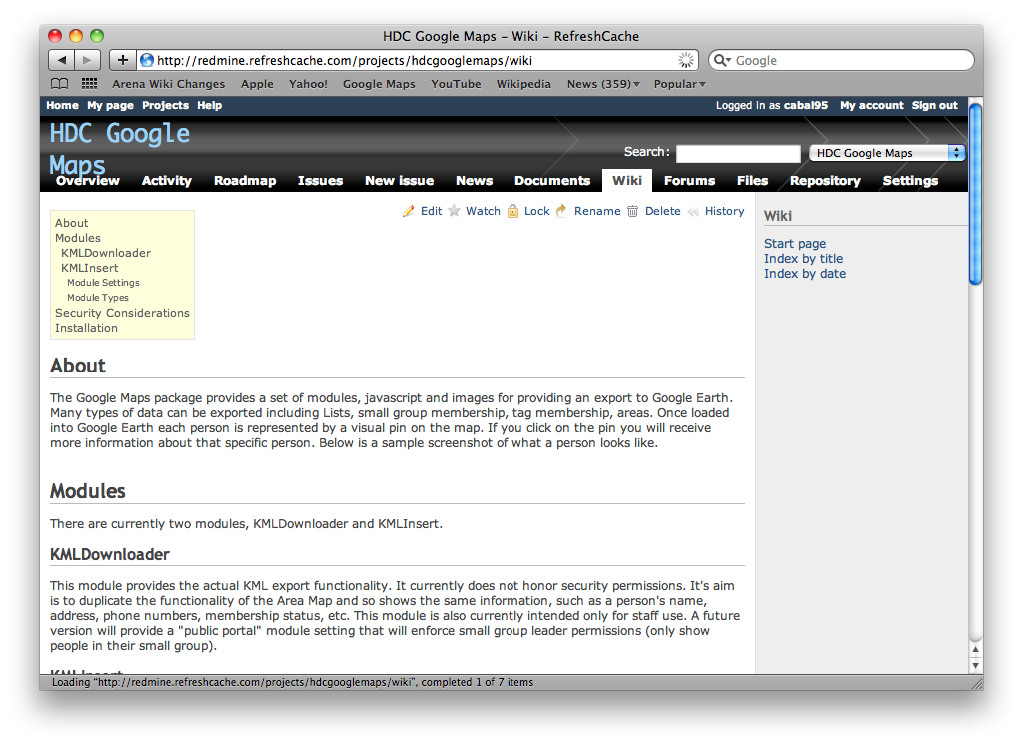

Slide 15
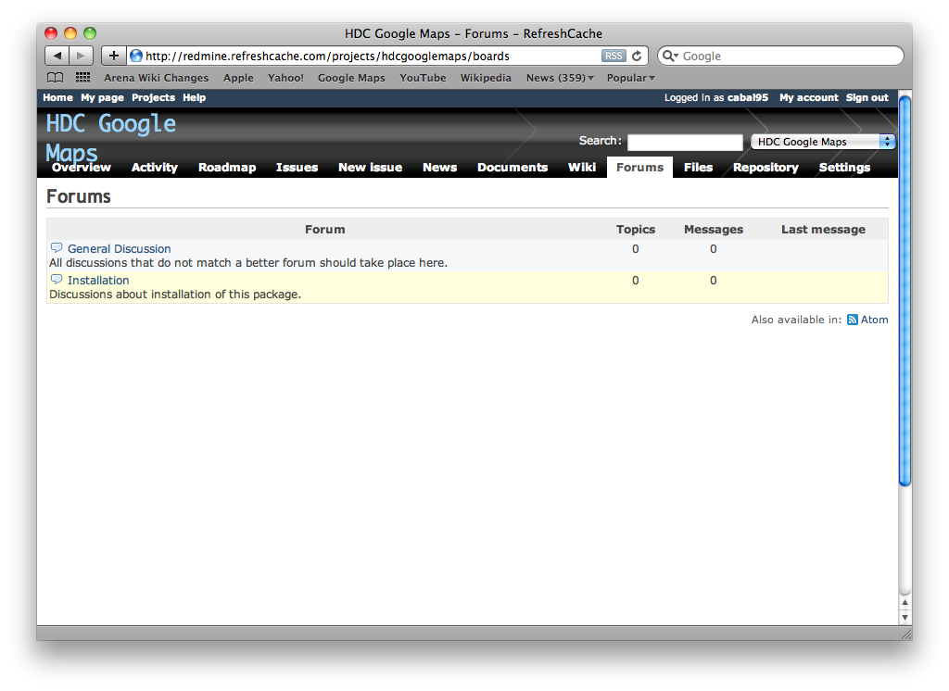

Slide 16
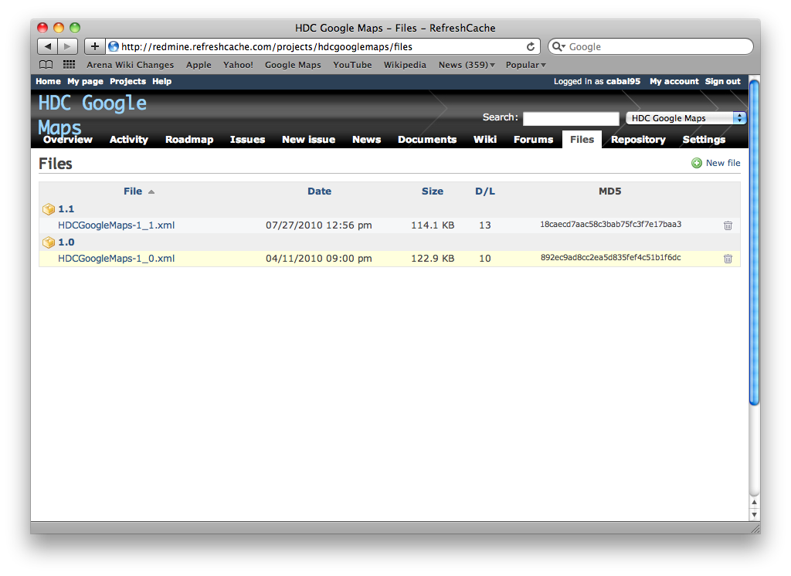

Slide 17
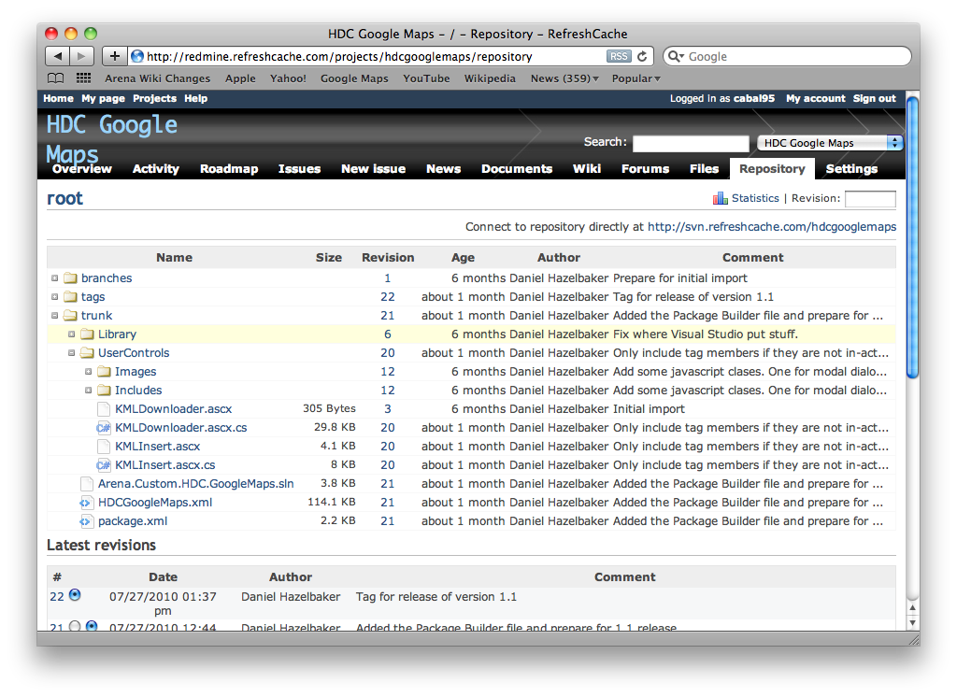

Slide 18
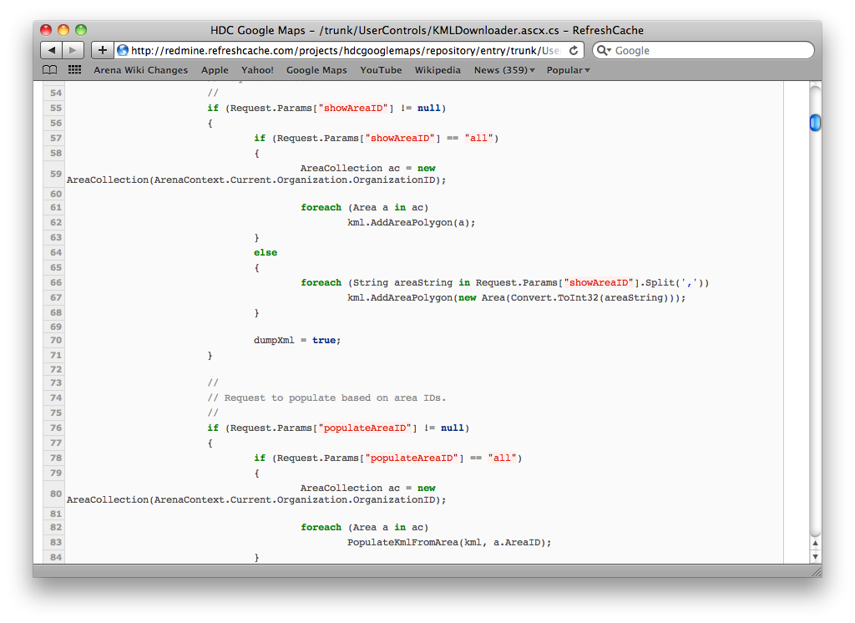

Slide 19

ReviewBoard
Keep your code changes bug free by asking for help with spotting those bugs.
Reviewboard was written by the folks at VMWare to help with the development of their Virtual Machine software. It is used by other companies such as Cisco, Digium, Electronic Arts, Tripwire, Twitter, Asterisk and KDE.

Slide 20
ReviewBoard
Solutions for the Developer
Post patch files that you have not yet committed to Source Control and get other developers to look over those changes for possible bugs.
Review other developer’s changes and leave comments about particular lines of code.
Post screenshots of how a new or redesigned user interface is going to look.
Review screenshots by selecting a region of the image and making a comment.

Slide 21
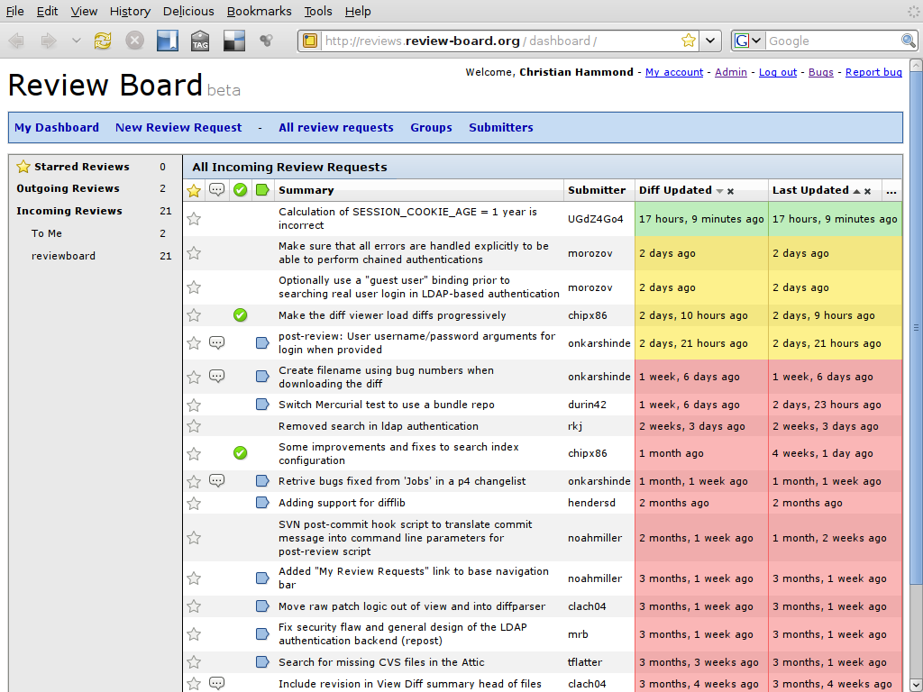

Slide 22
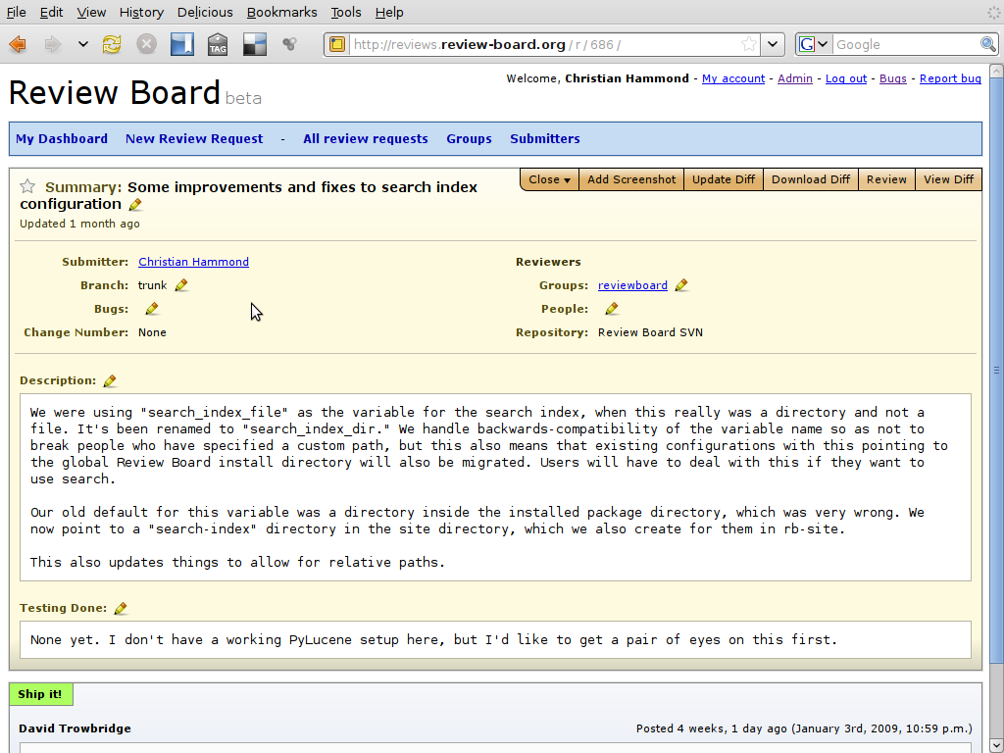

Slide 23
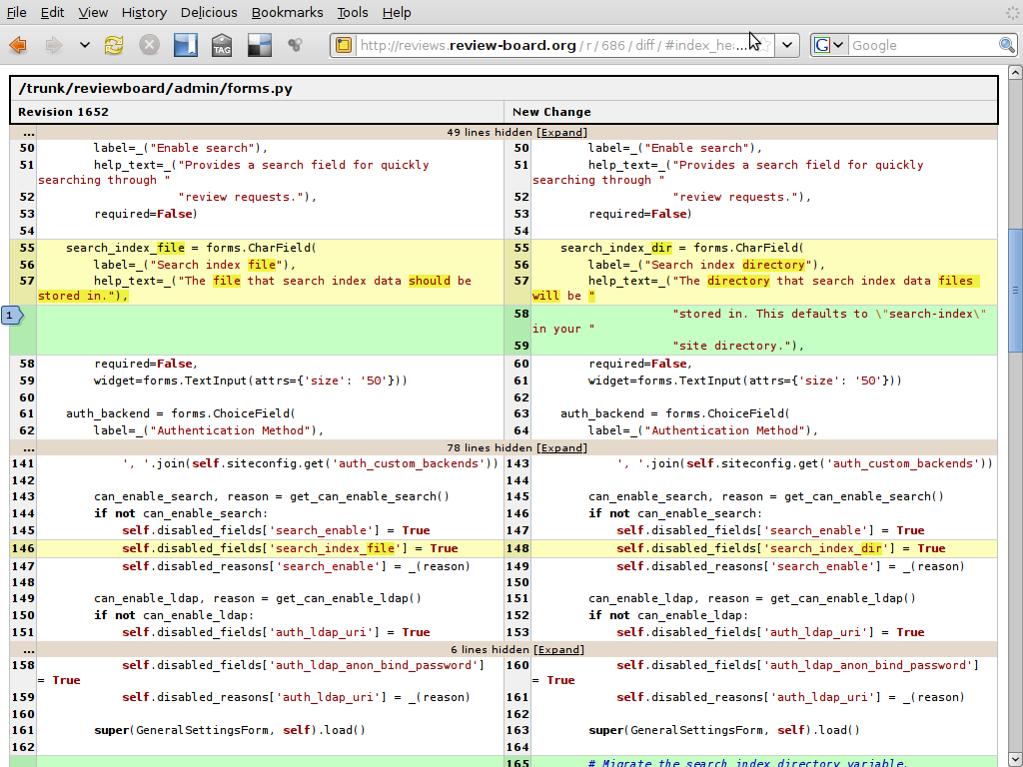

Slide 24
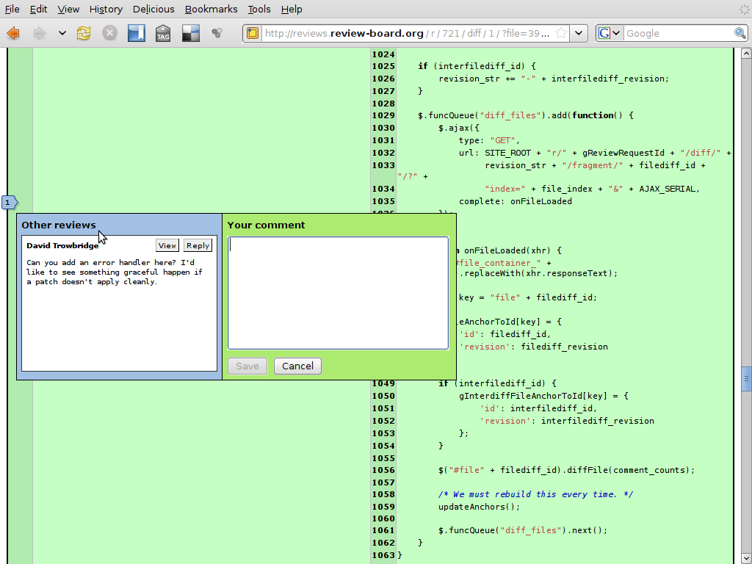

Slide 25
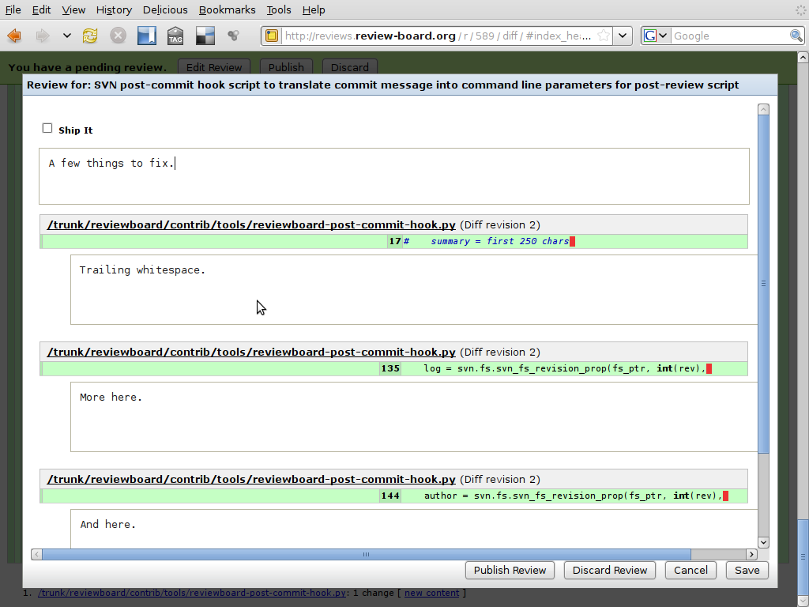

Slide 26
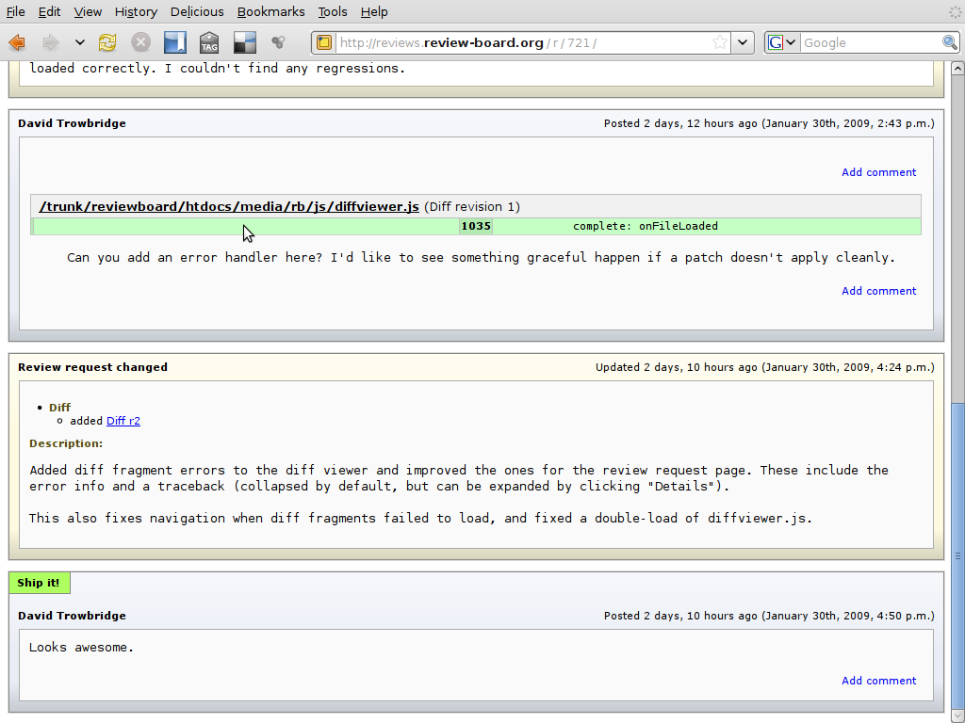

Slide 27
More Resources
Redmine @ RefreshCache – http://redmine.refreshcache.com/
ReviewBoard @ RefreshCache – http://reviewboard.refreshcache.com/

